Slide 1

Bill generator Application
My Simple bill generator
Amarjit Ningombam
21MCA2999
DISCOVER . LEARN . EMPOWER

Slide 2
CONTENTS
LIST OF TABLES
LIST OF FIGURES
Objective and Scope of the projects
1.1 Definition of project
1.2 Methodology
2. System Design
2.1 Code
3. System Environment
3.1 Hardware configuration
3.2 Software requirement
4 System requirement
5 Conclusion

Slide 3
LIST OF TABLES

Slide 4
LIST OF FIGURES
System architecture flow diagram--------------------
GUI creation code-----------------------------------------
Function for calculating the bill------------------------
Different labels for displaying the menu-------------
Billing section with entry--------------------------------
Model GUI--------------------------------------------------
Model input acceptance and computed bill--------

Slide 5
1. Objective and Scope of the project
python has been the most trending programming language used for object oriented programming. It earns its popularity being an interactive programming with various options for GUI (Graphical User Interface) framework. A high-level language, designed to emphasize code readability with high-level data structure. It helps developers to create applications easily in a secure manner. This project aims to develop a desktop application name Bill Generator using a python programming language.

Slide 6
Tkinter is the most popular programming package for GUI (Graphical user interface) application development, this project is developed based on it. Tkinter is a python binding to Tk GUI toolkit. It consists abundance resources of codes and reference which we find merit to consider it. It is free software released under a Python license. Our project deals with the development of a desktop application to generate bills for Food item. This software consist of Menu option with price of the food and on the other hand there consist of the input quantity to be ordered for the respective item and finally generating the bill

Slide 7
1.1 Definition of project
To develop a bill generator desktop application which compute total amount for the different ordered item from the Menu. It is a GUI based application developed using Tkinter method where implementation is proceed through python programming language. It is a user-friendly and light application, which can be used widely in many store.

Slide 8
1.2 Methodology
.
Bill generator system is a billing management system where one can easily generate total bill of the ordered item. It is developed using python support GUI option Tkinter. It consist a simple GUI window where it display the food item with its respective price. On the other side user needs to fill the quantity of the item for the respective item and within a second it generate the total bill for the ordered item.

Slide 9
This project idea can be applied in restaurants, cafe and mobile food truck etc for calculating bills in short period of time and its not time consuming. It’s easy to operate and understand by users. There is no any error and warning contents in the project. The design is so simple that user won’t find it difficult to use and navigate. Development process is performed using tkinter package. Where it make used of different widgets like Labels, Entry and the master window. It is 2 level unit where in the first level, the design and development of window is

Slide 10
done. With assignment of required options like size of windows, background color and titleetc. The second level consists of different labels and Entry. With Entry user enter the quantity of the item to ordered. Finally for those items the total amount bill is generated.

Slide 11
2 System Design
The system architecture flow is explained in figure 1. There consist four different modules in this application. The GUI module which consist of creation methods namely Window, Entry and Label. Window creation is a method of creating the GUI window. This is one of the main methods used for creating python application with GUI. To create the window, we used tkinter method tk with it we call mainloop method, normally it is an infinite loop used to run python application which work co-ordinate with the event.

Slide 12
Therefore as long as event process it do not close the window. Tkinter provide various widgets for developing the application. Entry is used to accept single-line text strings from the user. It consist of two different parameters namely master, options. With master representing the parent/ root window defined under GUI and the options consist list of options widget. The option include the bg, bd, command, font, fg etc. Of all for this experiment we have used the gui as the master and textvariable, bd as the options. Label, refer as display box for putting text and image and can be updated according to time.

Slide 13
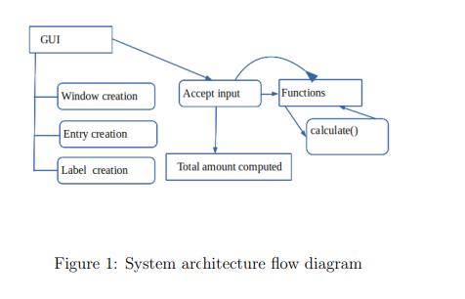

Slide 14
The button widget is used generate button in the application. It offer various options for changing the format, specific to our project we have used the height, width button only. To handle the geometric configuration of the widgets tkinter offer 3 class manager pack(), grid(), place(). grid() help us to organized widgets in table-structure format, therefore we have explore it in our experiment.

Slide 15
The first phase of implementation is the GUI window development for the application. As mentioned earlier the role of different widgets used in this project. This experiment proceed with complete design of Window, Label creation, Entry to accept input and result the equivalent total bill amount.
Inside the created window firstly it begins with different label creation which result label of different food items and the respective price. The left side column accept the different amount of quantity item and lastly their respective bill is calculated

Slide 16
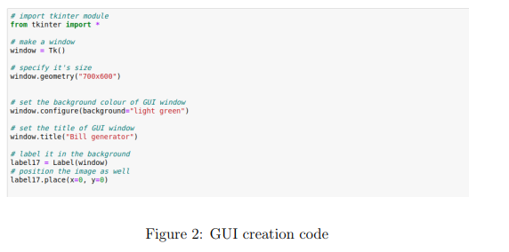

Slide 17
over. The function calculate() compute the total bill where each item is stored in the form of dictionaries. Dictionaries consists of key and values for storing the data. An unordered collection of data values, used to store data values like a map unlike datatype that hold single value element. The key-value is provided to make it more optimized. Using this dictionaries the calculate function compute the total bill amount. The function return the computed value in an entry, which display the total bill. Every implementation phase is performed within the mainloop.

Slide 18
2.1 Code
We use jupyter notebook as editor to implement the code for this project. Given figure 2,3,4, 5 are the different section of code with its respective task as mention in the caption

Slide 19
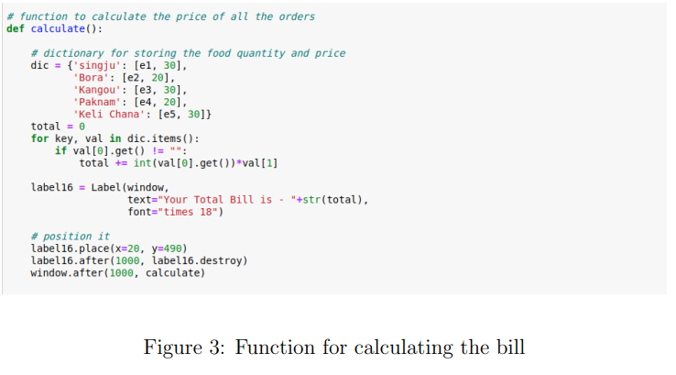

Slide 20
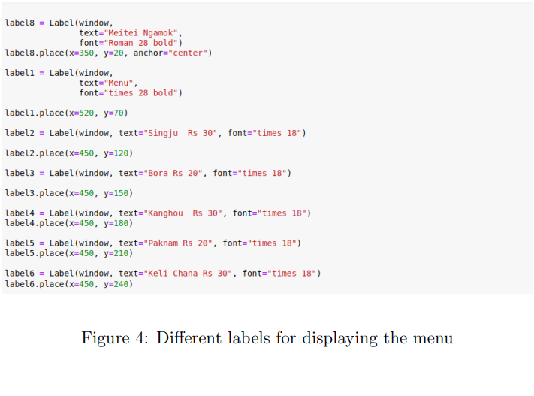

Slide 21
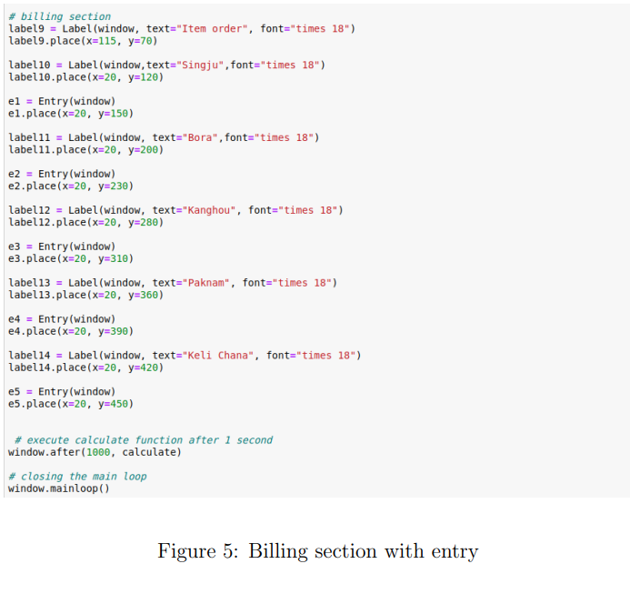

Slide 22
3 System Environment
This section deliver the different hardware and software requirement for the development of the project. Listed below are the software and hardware configuration for the system engaged for the development of this project.

Slide 23
3.1 Hardware configuration
Processor: i7-8700 CPU @ 3.20GHz * 12
Memory: 15.4GiB
Graphics: Intel UHD Graphics 630
Operating system type: 64-bit
Hard Disk: 485.4 GB

Slide 24
3.2 Software requirement
Given below are the software requirement. We have developed the model over Ubuntu environment with 18.4 version. With python as the programming language supportive library required to developed the system is the tkinter.
1. Operating system: 18.4 Ubuntu
2. Programming language: Python
3. Version: Python 3

Slide 25
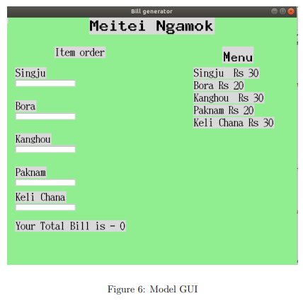

Slide 26
4. Libraries: tkinter
However, this application is feasible to execute over Windows and Linux environment with necessary library and programming language install.

Slide 27
4 System Implementation
Given Figure 6, 7, define the various implementation execution phase of the project.

Slide 28
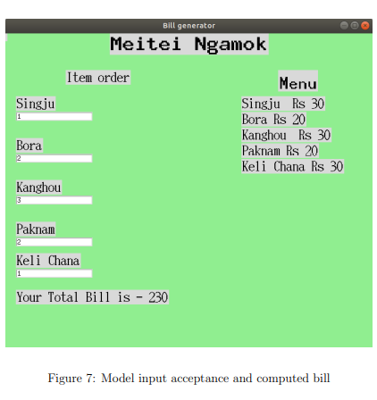

Slide 29
5 Conclusion
This project develop an desktop application ”Bill generator” based on python programming language which performed computation of bill amount for different items in the menu. It accept number of quantity as input for the calculation and result the computed value. Therefore, we have successfully implemented the objective and describe the system development architecture in various sections.

Slide 30

THANK YOU

